Slide 1
Technology in Early Child Development
By: Destiny Mancini
CSIT100_37

Slide 2
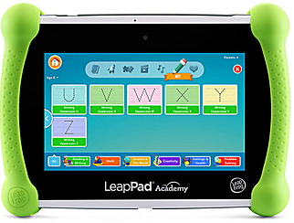
Examples of Technology Children Use
Devices
tablets, smartphones, and computers
Companies such as LeapFrog provide devices for children to use as educational and gaming tools without having access to the internet.
Example of a LeapFrog device: LeapPad Academy
For ages 3-8
Educational learning tablet for early childhood that includes 20 expert approved apps that teach core school and life skills
Teaches skills such as:
Coding
Creative expression
Earth & space science
Spelling
Reading comprehension
Mathematical reasoning
Etc.

Slide 3

Examples of Technology Children Use
Technology Sources
Educational apps and online learning platforms
Provide high-quality educational content that cover many different topics such as science, math, spelling, reading comprehension, etc
Example: ABCMouse.com
An online learning program for children ages 2-8
Features hundreds of interactive games to teach children different educational topics
Virtual reality experiences
Provide unique and interactive learning experiences that can not be replicated in a regular classroom setting

Slide 4
Examples of Technology Children Use
Assistive technology
Beneficial for children with special needs who may have difficulties with speech
Example: Text-to-speech software
Helps children who are nonverbal have a form of communication with their peers; provides improvement in socialization, communication, and independence
Gaming
Gives children the opportunity to develop crucial life skills such as problem-solving, critical thinking, and strategic planning

Slide 5
Cons of Technology Use in Childhood: Attention Spans
“Jim Taylor, Ph.D., wrote in Psychology Today that heightened technology exposure might actually be changing the way children’s brains are wired…When children are exposed to technology at high rates, their brain may adopt an internet approach to thinking – quickly scanning and processing multiple sources of information. Developing brains are particularly vulnerable to this, and where previous generations may have spent much more time reading, imagining, or participating in activities that require focus attention, brains in children exposed to high volumes of technology may adapt to frequent visual stimulation, rapid change, and little need for imagination.” (How Technology Affects Child Development).

Slide 6
Cons of Technology Use in Childhood: Poor Mental Health
“Adolescents who spent more time on new media (including social media and electronic devices such as smartphones) were more likely to report mental health issues, and adolescents who spent more time on nonscreen activities (in-person social interaction, sports/exercise, homework, print media, and attending religious services) were less likely. Since 2010, iGen adolescents have spent more time on new media screen activities and less time on nonscreen activities, which may account for the increases in depression and suicide.”
“Observation is the primary way children learn, as they listen to learn the language, observe conversations, read facial expressions and watch how others navigate emotional situations. Rampant screen time seeps away intentionally, connected time with children that is critical to emotional development”

Slide 7
Cons of Technology Use in Childhood: Poor Physical Health
“With children spending more time typing or tapping on a screen, they’re naturally spending less time outside or engaged in physical activities. Research has also found that children and adolescents may engage in more mindless eating while watching TV or playing video games. As a result, we’re seeing increased obesity rates in children and adolescents.”
“Researchers have observed a significant effect on sleep for children who use electronic devices in their bedroom within two hours of bedtime. Screen time within this window has been linked to inadequate sleep duration, poor quality sleep, and excessive daytime sleepiness the following day…As little as 90 minutes of screen time in the evening can elevate feelings of alertness and make falling asleep more difficult for kids.”

Slide 8

Pros of Technology Use in Childhood
Helpful learning tool:
Technology helps create a fun and interactive way for children to learn in a classroom or even at home. It can help reach children with different learning styles and motivate students in new ways.
Preparing for the future:
In the past few decades, technology has evolved rapidly and will continue to do so moving forward. Exposing children to technology at a young age starts to prepare them for these changes early on.

Slide 9
Pros of Technology Use in Childhood
Improves…
Multitasking
Technology helps children learn how to multitask. For example, children can learn how to listen to their teachers while also physically taking notes in the classroom.
Visual-spatial development
Video games help children develop good visual-spatial skills which is useful for reading maps or solving puzzles.
Problem solving and decision making
Technology can present issues that children can learn how to solve which strengthens their problem solving skills and how to decide what a best possible solution is for an issue presented to them.

Slide 10
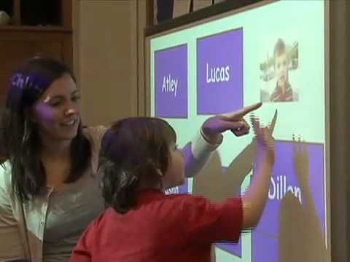
Video
https://www.youtube.com/watch?v=wOhb4n4ADbM

Slide 11
Tips for Teachers
Have a plan when using technology in the classroom
Do not let students aimlessly scroll on technology; create a plan for what they need to accomplish and have clear objectives and reasoning for the activities.
Be hands-on and active
Choose activities where children are using technology while also being active and hands-on rather than just sitting and scrolling or sitting and watching for long periods of time.
Use technology carefully
Make sure to have safeguards on any technology that children will be interacting with and have proper training of how to handle technology in order to keep children safe.

Slide 12
Tips for Teachers
Use a variety of devices
Give children the opportunity to learn how to navigate different types of technology. It is important for children to know how to use a computer with a proper keyboard and mouse along with a touchscreen device or an actual camera.
Use technology with parents and other staff members
Technology makes communication quick and easy. Be open and willing to use technology as a form of communication with parents of students along with other staff members.

Slide 13

Tips for Parents
Explore technology with your children in order to allow them to learn skills with devices while being supervised and it strengthens the relationship as well.
In addition to spending time together on screens, also prioritize off screen bonding such as playing outside
Monitor what kind of content children are consuming on the internet; make sure it is beneficial and not a danger to them

Slide 14

Tips for Parents
Monitor how much time is being spent on technology. The World Health Organization recommends, “Children under the age of 5 should not spend more than 60 minutes a day in passive activities in front of a smartphone, computer, or TV screen. Children under 12 months of age should not spend even a minute in front of electronic devices.”

